Slide 1
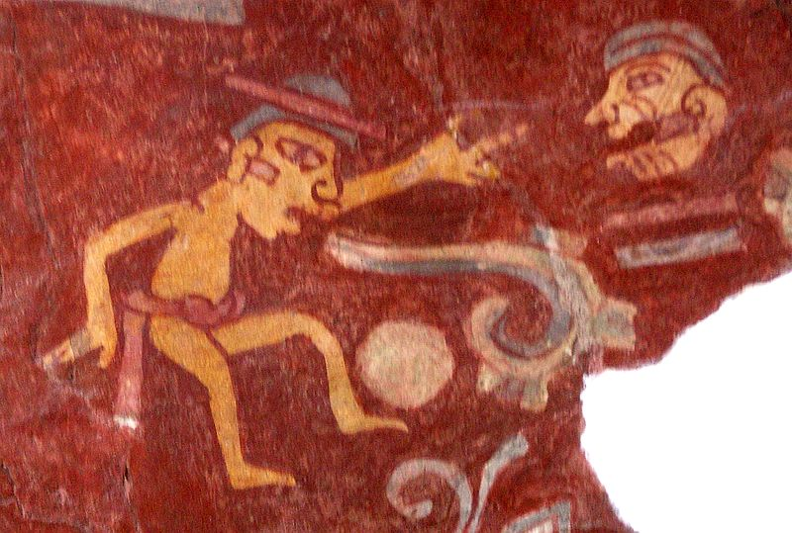
LINGUISTICS

Slide 2
THE STUDY OF LANGUAGE
BY
GEORGE YULE

Slide 3
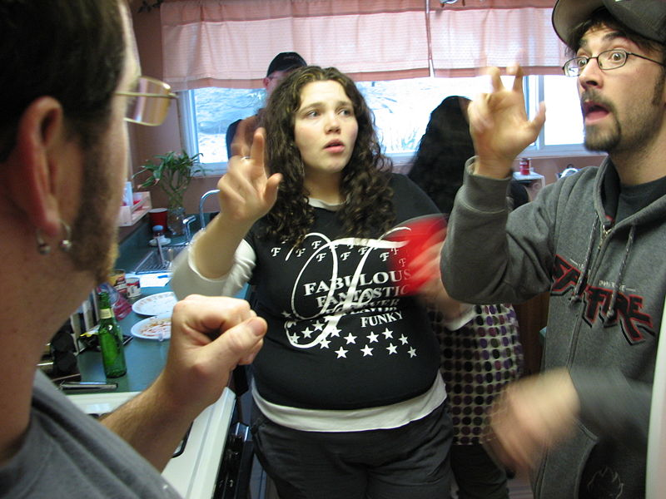

Slide 4
PRAGMATICS
DISCOURSE ANALYSIS
Language and Brain
First Language Acquisition
Second Language Acquisition / Learning
Language, History and Change
Language and Regional Variation
Language and Culture
Language and Social Variation

Slide 5
WHAT’S LANGUAGE ?

Slide 6
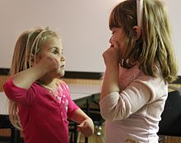
Language is a social system

Slide 7
Language is a system of signs for encoding and decoding information.

Slide 8
language is a formal system of signs governed by grammatical rules of combination to communicate meaning.

Slide 9
This definition stresses the fact that
human languages can be described as
closed structural systems consisting of
rules that relate particular signs to
particular meanings.

Slide 10
One definition sees language
primarily as the mental faculty that
allows humans to undertake
linguistic behaviour: to learn
languages and produce and
understand utterances

Slide 11
Language is a tool for communication

Slide 12
Why do people use language ?

Slide 13
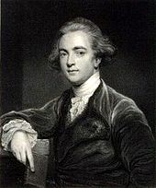
William Jones discovered the family relation between Latin and Sanskrit, laying the ground for the discipline of Historical linguistics.

Slide 14
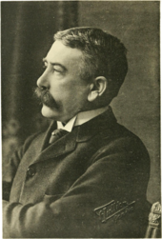
Ferdinand de Saussure developed the structuralist approach to studying language.

Slide 15
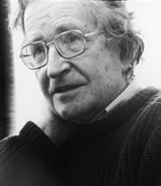
Noam Chomsky is one of the most important linguistic theorists of the 20th century.

